Slide 1
COVID-19
Images Segmentation
Mohab Mohamed , 221002016
Yousef Abdallah , 221002152
Eng Hady Yaser

Slide 3
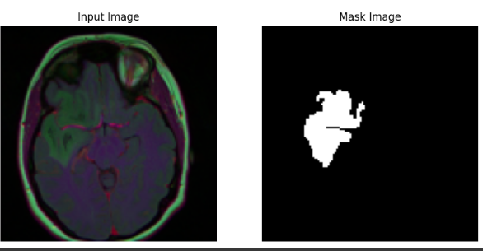

Slide 4
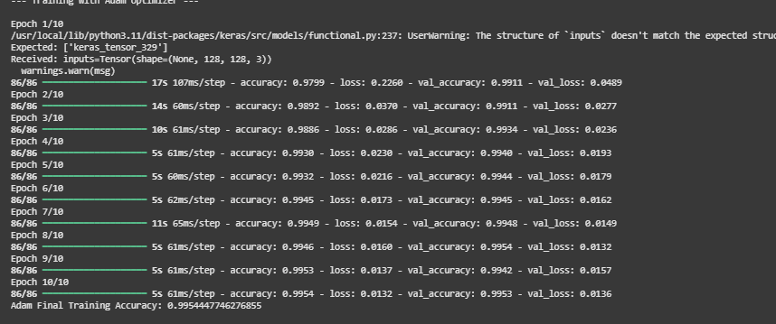

Slide 5
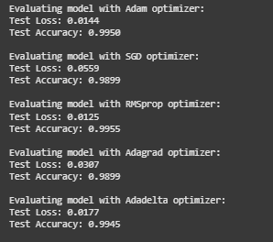

Slide 6
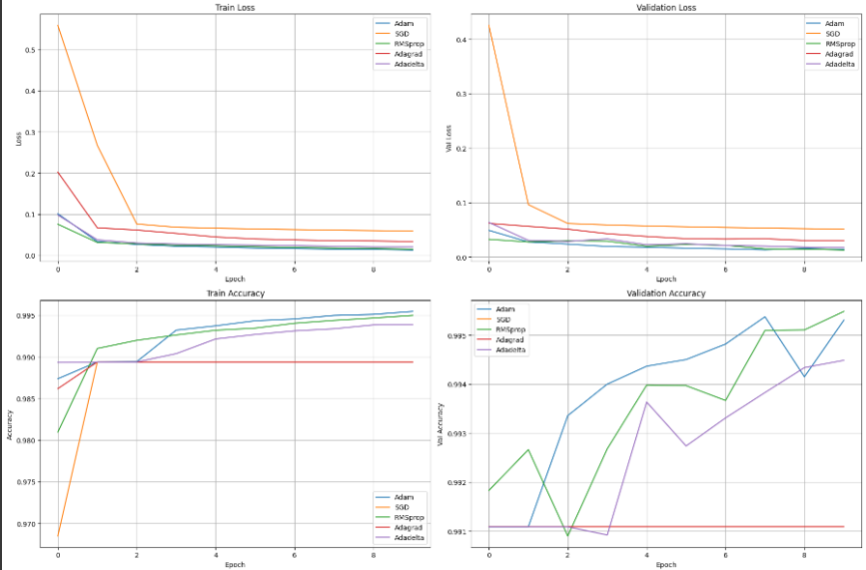

Slide 7
